Slide 1
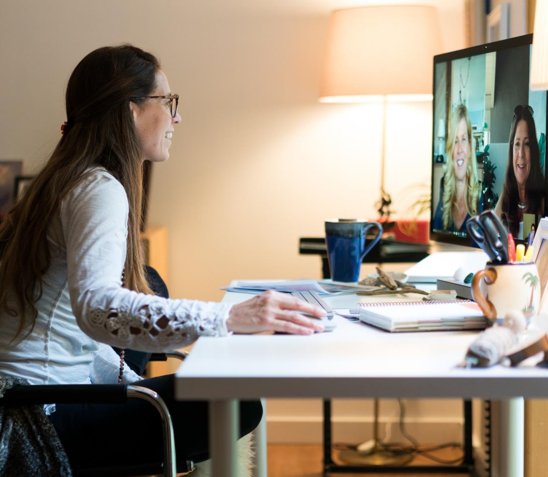
04 Microsoft MVP Summit Case Study

Slide 2



Story Time – Microsoft MVP Summit
4 Day Global Event
30 day runway
Multi Day, Multi Track
15 executive meetings 800+ sessions including repeats 3,300 guests loaded to the tenant
Attendee Experience: Microsoft Teams
Teams Live Events
Channel Meetings
Embrace the difference: preparation & communication critical

Slide 3
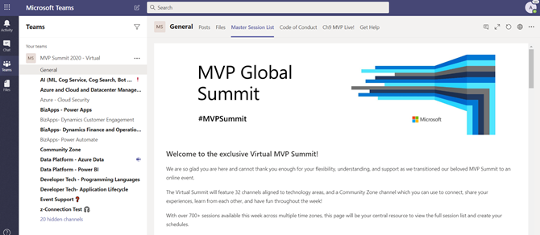
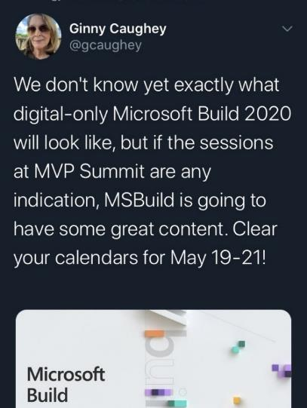
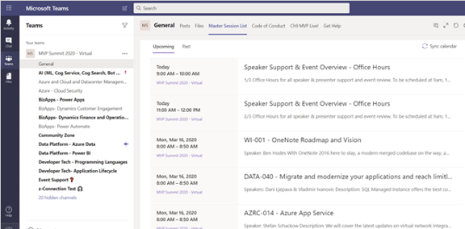

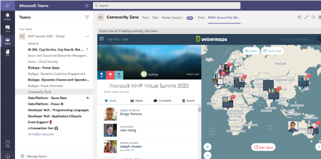
MVP/RD Summit Recap
Situation
Due to the pandemic, we quickly transitioned our previously scheduled MVP/RD Summit in March to a virtual event. This event brings together Microsoft executives, product leaders and developers with our Most Valuable Professional (MVP) and Regional Director (RD) communities and served all Microsoft product areas including Azure, Microsoft 365 and Business Applications Groups. The event was produced by Karuana Gatimu of the Customer Advocacy Group in Microsoft Teams and hosted on the Microsoft Tenant to validate our virtual event strategy in this unfamiliar situation.
Results
Feedback: Roundly positive, with gratitude for not canceling the event and providing an outlet for connectivity with supportive peers
Chat logs were very active with users staying all day, across multiple times zones
4,826 users in MVP Summit team; 230 users in RD Summit team
Maintained high engagement throughout 3-day schedule with 3844, 3622, and 3388 active users
Day-over-day drop-off were much lower than anticipated for an online/virtual event
Users interacted with Presenters and each other at an unprecedented scale (Community Zone!)
Over first 3 days saw 15,758, 18,404, 18,647 messages respectively
Engagement saw 2,162 tweets with #MVPSummit hashtag reaching 3.4m people and generating 8.5m impressions with extremely high sentiment

Slide 4
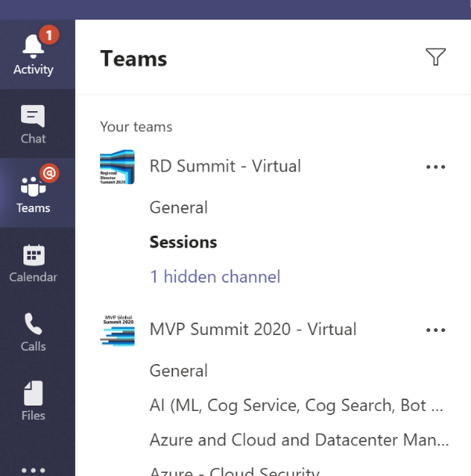
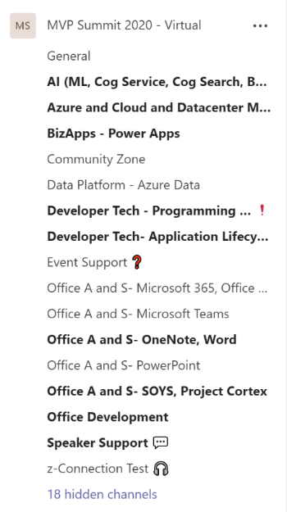
MVP Summit Team Design
Custom produced Teams Live Events for keynotes
Conference information hosted on SharePoint included with Microsoft Teams
On-demand content hosted in a Stream channel for follow-up viewing
Channels for each track
Main agenda and links in SharePoint page pinned in Teams
Each session scheduled as channel meeting
Community Zone channel
Event Support channel
Speaker Support channel
Private channels for event organizers
Custom survey tool used for session feedback; results aggregated in Power BI dashboard
152

Slide 5
